Slide 1

WELCOME
to the Thesis and Dissertation Formatting Tutorial
Notes:
Good Morning and Welcome to the Thesis and Dissertation Formatting Tutorial. My name is Kate, and I am one of the thesis and dissertation administrators at the Graduate School. I hope you find the following tutorial informative and useful in preparing your document for publishing. This webinar is being recorded and will be available on the Graduate School website after this presentation.
We have another ETD administrator running the Q&A chat, so please feel free to drop questions there throughout the presentation.

Slide 2
This tutorial is always available on the Graduate School’s website
(https://grad.msu.edu/etd) along with the formatting guide, sample pages, and instructions on how to submit your thesis or dissertation through the ProQuest website.
Notes:
On our website, along with this tutorial, you will find the current formatting guide, sample pages, and instructions on how to submit your thesis or dissertation through the ProQuest website.

Slide 3
Graduate School
Graduate School
Michigan State University
Chittenden Hall
466 W. Circle Drive
East Lansing, MI 48824
Phone: 517-353-3220
Email: msuetds.approval@grd.msu.edu
Notes:
The Graduate School is located in Chittenden Hall on West Circle Drive.

Slide 4
What will this formatting workshop teach you?
Where to find the formatting requirements and how to FORMAT your thesis or dissertation
How to successfully SUBMIT your electronic thesis or dissertation via ProQuest
How to successfully COMPLETE your Graduate School requirements to finish your degree and receive your diploma
Notes:
What will this formatting workshop teach you?
It will teach you:
How to format your thesis or dissertation correctly.
How to successfully submit your electronic thesis or dissertation via ProQuest’s website.
And how to successfully complete the Graduate School requirements to finish your degree to receive your diploma.

Slide 5
Who is this for?
These requirements apply to all Ph.D. dissertations and all “Plan A” Master’s theses.
“Plan B” Master’s students should contact their department regarding their papers. “Plan B” theses DO NOT get submitted through ProQuest.
Notes:
These requirements apply to all dissertations and all Plan A Master’s theses.
Plan B master’s students should contact their department regarding the submission of their papers. Plan B theses do not get submitted through ProQuest.

Slide 6
Submission & Final Deadlines
Submission Deadline:
The submission deadline is for the initial submission of your thesis or dissertation to ProQuest. The document must be in its final version, meaning it has been successfully defended, committee corrections have been made, and there are no more content changes.
We will not accept documents for review for the current semester after 5:00pm ET on the Submission Deadline Date.
Final Deadline:
Each semester has a firm, final deadline where documents must be accepted and delivered for publishing, all necessary paperwork must be turned in, all milestones must be completed, and all degree audits must be completed.
Notes:
Regarding deadlines:
As of Fall 2022, we have a submission deadline and a final deadline. The submission deadline is for the initial submission of your thesis or dissertation to ProQuest. The document submitted needs to be the final version, meaning it has been successfully defended, corrections the committee wants have been made, and there are no more content changes. The Graduate School will not accept documents for review for the current semester after 5:00PM ET on the submission deadline date.
The Final Deadline is where documents have been accepted and delivered for publishing, all required paperwork has been turned in, all milestones have been completed and all degree audits have been completed. Your document must be accepted and delivered to the publisher, ProQuest, by 5:00PM ET on the final deadline date.
These are both firm deadlines.

Slide 7
Deadline Dates
Spring 2025
  Submission Deadline:
      Wednesday, July 30, 2025 at 5:00p.m. ET
  Final Deadline:
      Wednesday, August 13, 2025, at 5:00p.m. ET
Fall 2025
  Submission Deadline:
      Monday, December 1, 2025, at 5:00p.m. ET
  Final Deadline:
      Monday, December 15, 2025, at 5:00p.m. ET
Notes:
Here are the deadline dates for Summer and Fall of 2025. Our website currently lists deadlines through Fall 2027.

Slide 8
Templates
The Graduate School DOES NOT support or endorse any type of template for thesis or dissertation writing other than the Word-based Title Page Templates we provide on our website.
Regardless of the method or template used, the document must meet the Graduate School formatting requirements.
We are looking at your final product, not how or what you used to produce your document.
Notes:
If you use any sort of formatting template or program to produce your document, please note:
The Graduate School does not support or endorse any type of template for thesis or dissertation writing other than the 3 Word-based title page templates we provide on our website.
Regardless of the method or template used, the document must meet the Graduate School formatting requirements set by the university.
We are looking at your final product, now how you produced your document.

Slide 9
Consistency
Whatever formatting method you choose to use in your document must be employed throughout the ENTIRE DOCUMENT. The method you choose must follow the Graduate School’s formatting requirements.
Notes:
For any formatting method that you choose, please remember that consistency is the key.
For example: if you number your headings and sub-headings in one chapter, then you should do the same in all chapters.
If your headings are in bold type in one chapter, then they should be in bold type in all chapters.
If you have all your figures and tables in an appendix in one chapter, then your figures and tables should be in appendices in all chapters.
It seems simple, but we do see quite a few inconsistencies in documents regarding issues like these.

Slide 10
Please Use This Website https://grad.msu.edu/etd
This is where you will find the link for the current Formatting Guide for Electronic Submission of Master’s Theses and Doctoral Dissertations.
***We are using an updated formatting guide starting Fall 2022***
Make sure you read and follow the formatting guide BEFORE you submit your document to ProQuest via the Graduate School website. The Graduate School’s task is to review your formatting, not to format the document for you.
Notes:
As a reminder—Please use the Graduate School’s website listed here to assist you in the preparation of your document.
Make sure you read and follow the formatting guide when preparing your document and before you upload your document to ProQuest. The Graduate School’s task is to review your formatting NOT to format your document for you.
We don’t like to give multiple pages of corrections to people, but we often must do so because people don’t read and follow the formatting guide. As you can see, we do have an updated formatting guide which is less restrictive than the previous one. For example, the LIST OF TABLES and LIST OF FIGURES are no longer required, and we encourage you to not include them as they will increase the time it takes for reviewers to review your document.

Slide 11
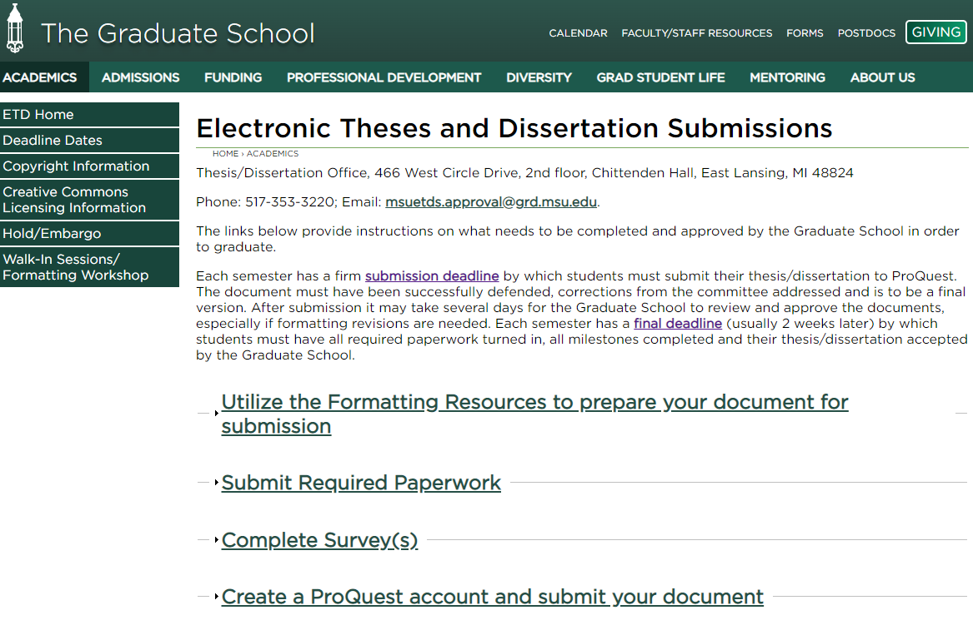
Screenshot of all sections on https://grad.msu.edu/etd
Notes:
When you go to the Graduate School’s Thesis and Dissertation website you will see the following:
The ETD Menu is on the left side of the screen. Here you will find links to the deadline dates, copyright information, Creative Commons Licensing Information, Embargo information, and walk-in session and workshop information.
Also, each heading on this page has a drop-down menu which presents you will additional information and resources.

Slide 12
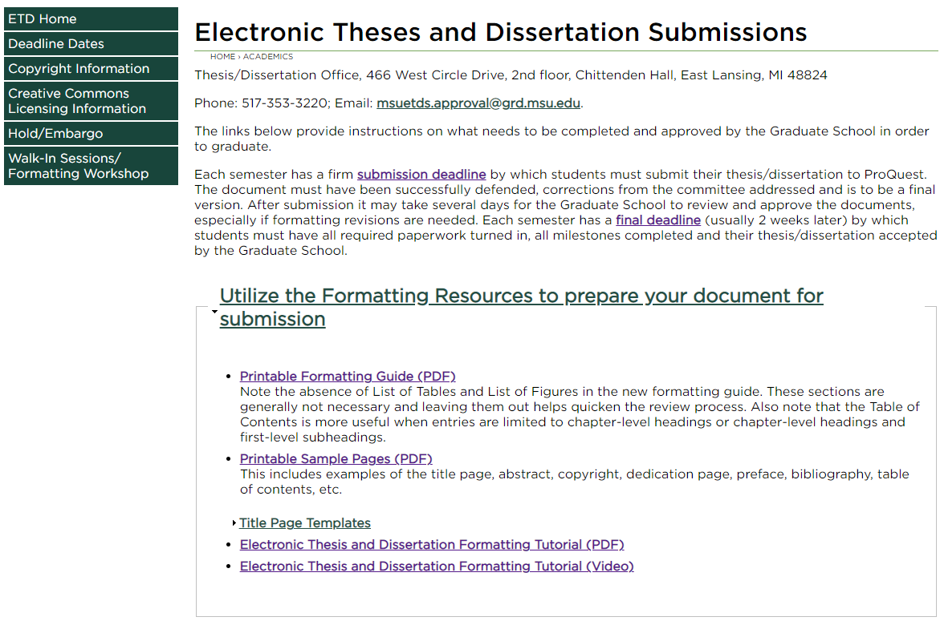
Screenshot of the Formatting Resources
Notes:
When you click on the first heading, this is the drop-down menu you will see. Here you can locate the formatting guide, sample pages, Title Page Templates, and this formatting tutorial and slide deck (which will be uploaded shortly after today’s presentation).

Slide 13
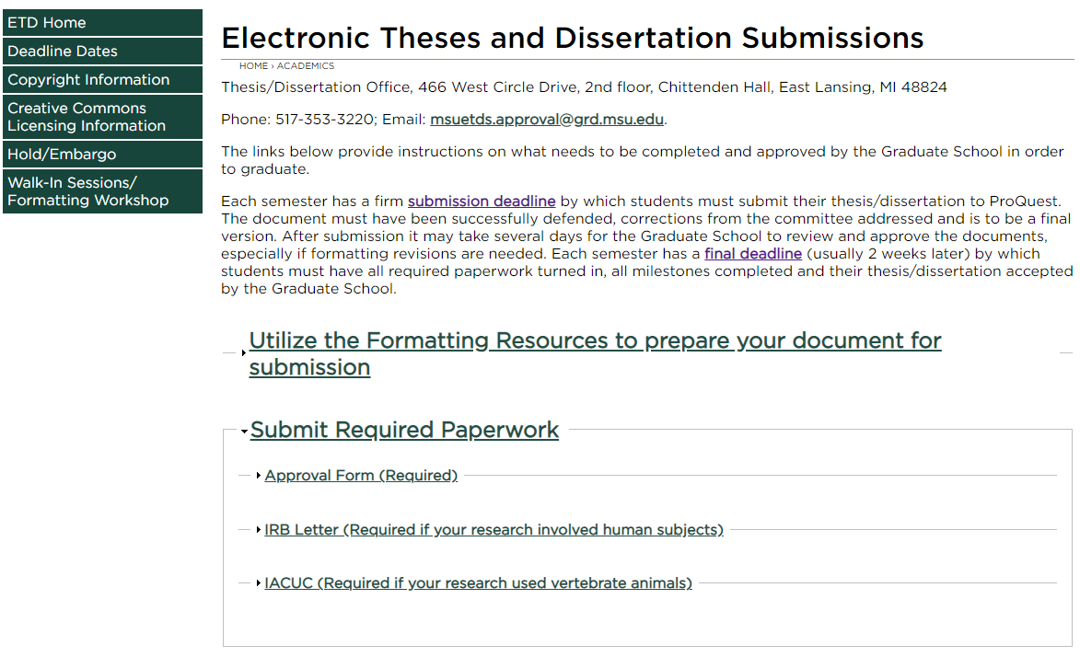
Screenshot of the Required Paperwork
Notes:
The second heading will open the drop-down menu you are currently seeing. Here you will find your ETD approval form link. The ETD approval form is required for all documents, and it is not the same as your Proof of Defense. The proof of defense is not part of the required paperwork for the Graduate School.

Slide 14
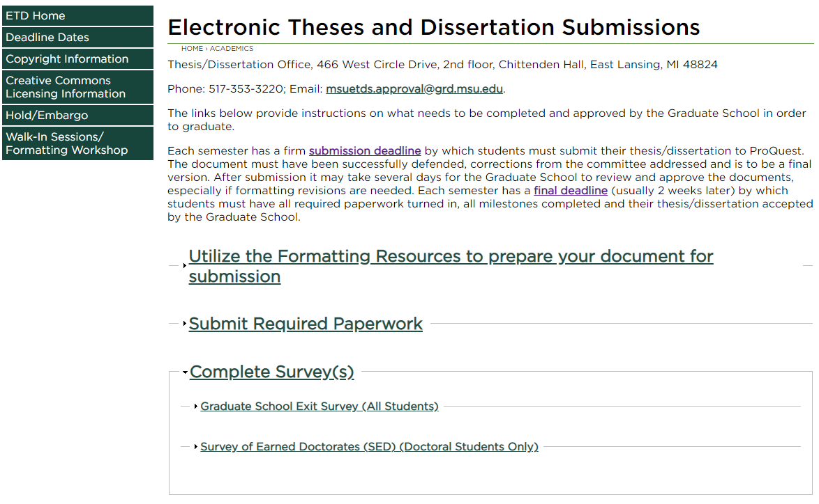
Screenshot of the Required Surveys
Notes:
The third heading provides you with the Graduate School Exit Survey and the Survey of Earned Doctorates. The first survey is for everyone the SED is only for doctoral students.

Slide 15
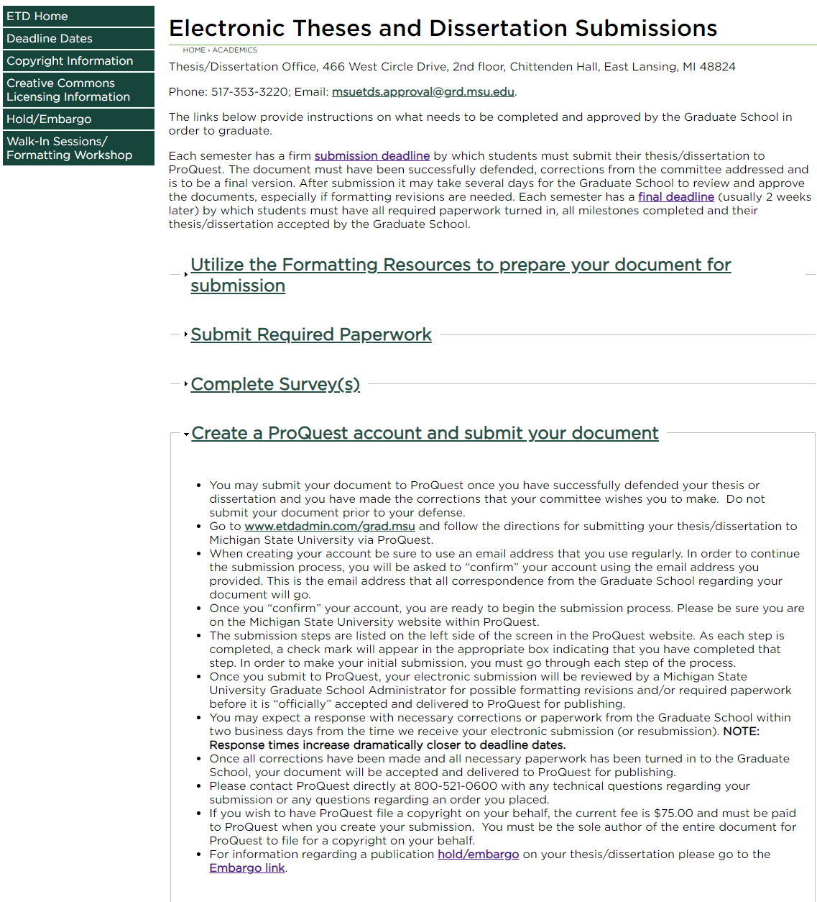
Screenshot of Creating Your ProQuest Account Information
Notes:
The last heading gives you the directions for creating a ProQuest account which you will need to do to submit your document.
Please note that we aim to get corrections out to students within 2 business days, however as we get closer to deadlines the response time will increase substantially as we see a large influx of submissions. So, the earlier you can get your document in, the better.

Slide 16
Your name throughout your submission
Your name must match in ALL aspects of your submission. It must match in the following areas:
  On your Approval form
  In your ProQuest ETD (Electronic Thesis and Dissertation) contact details
  On your title page
  On your copyright page (if applicable)
Notes:
The next few slides cover some general things regarding your submission and your document.
A few notes about your name. Your name must match in all aspects of your submission.
This means it must match on the approval form, in the contact information in your ProQuest account, on the title page of your document, and on the copyright page of your document (if you have a copyright page). Please note it must be the name recognized by MSU’s registrar’s office so that it can be matched up at the end of the semester to confer your degree.

Slide 17


MARGINS
All margins must be between 1-inch and 1.5-inches all the way around (top, bottom, left, and right) and consistent throughout the ENTIRE document.
NOTE: ProQuest does not require a left margin larger than 1 inch for bound copies.
Notes:
Throughout the entire document margin requirements must be followed.
All margins must be between 1 inch and 1.5 inches (top, bottom, left, and right) and consistent throughout the entire document. Some pages in the document do have specific requirements about where text is to be located, so you will need to note that when creating your margin settings for your document. This image shows what a 1-inch margin all the way around the page looks like.
Please note: ProQuest does not need a margin larger than an inch for bound copies. So, your left margin does not need to be larger than 1 inch for binding.

Slide 18
Spacing
The document may be 1.5-spaced or double-spaced.
Single-spacing is allowed for the following: titles, headings, footnotes, endnotes, references, lengthy quotations, bulleted/numbered lists, figure/table captions, or material in an appendix
Notes:
Regarding spacing:
The text of the Abstract, Acknowledgements, Preface, and general text of the body of the document may be 1.5-spaced or double-spaced and must be consistent throughout the document.
All double (or 1.5) spaces are to be the size that is between lines of text in the body of the document.
Some pages do have specific spacing guidelines, so please make sure to follow those as you prepare your document for submission.

Slide 19
Every thesis or dissertation is composed of three parts
1. Preliminary pages
2. Body of the Document
3. Reference Materials (Bibliography/Appendix)
Notes:
Every thesis or dissertation is composed of three basic parts.
The preliminary pages
The text or body of the document
And Reference materials—your Bibliography and Appendix

Slide 20
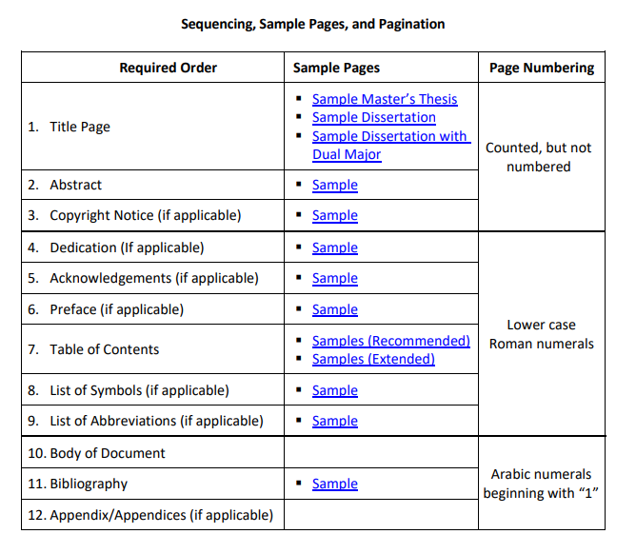
Sequencing, Sample Pages, and Page Numbering
Notes:
To know what order your pages are to appear, what pages require page numbers, and for sample pages, you should refer to this table which can be found on page 3 in the formatting guide.
The first and second section (numbers 1-9) are the preliminary pages: You can see the sequence of pages in the left column, the link to the sample page in the middle column, and the page numbering in the right column. You will notice that the first section (numbers 1-3) have pages that are counted, but not numbered while the second section (numbers 4-9) are numbered with lowercase roman numerals. The first page with a page number would be the Dedication page (if included).
The body of the document and reference pages are in the third section (numbers 10-12). Please note that these pages are numbered with Arabic numbers and that the body of the document starts on page 1.
Page numbers are always to be placed ½ inch to an inch from the bottom of the page regardless of page orientation (landscape vs. portrait). Page numbers are the only text permitted to be in the margins.

Slide 21
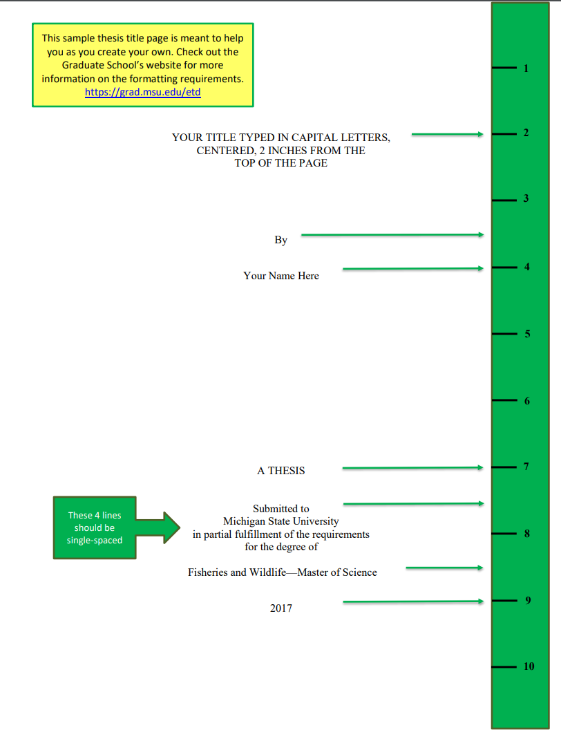

Sample THESIS Title Page
Sample DISSERTATION Title Page
Notes:
Here, we have sample Thesis and Dissertation title pages. The title is to be in all capital letters, single spaced, and centered left to right, 2 inches from the top of the page.
As you can see, then at the 3.5 inch mark the word “By” and at 4 inches you have your name.
A THESIS or A DISSERTATION is now at 7 inches.
The next section beginning with “Submitted to” and ending with “for the degree of” is to be single spaced and start at 7.5 inches.
After this section, your degree granting unit and degree is at 8.5 inches and the year at 9 inches.
As a reminder, this page is counted, but not numbered. The title pages have Word-based templates on our website that you can download and then just plug in your information in the appropriate spots. We did this because we want a uniform, professional looking title page so it has the most rules of all the pages in the document.

Slide 22

Sample
Dissertation title page with dual majors
Notes:
The example here shows the Dissertation title page with a dual major.
The main degree granting unit and degree are to be written on the first line. Then, single space to the next line and write the dual degree granting unit and degree.

Slide 23
If you are unclear on how to write your degree granting unit and degree, please see the Registrar’s Website
A complete list of Graduate Degree Granting Units and Programs is available on the Registrar’s website at: https://reg.msu.edu/AcademicPrograms/Programs.aspx?PType=GR Only the units/programs listed here are approved by Michigan State University.
Notes:
If you are unclear on how to correctly write your degree granting unit and degree, you may find the current list taken from the registrar’s website by clicking on the link on this page.
Only the programs listed here are approved by Michigan State University. It is important to note that your degree should match what your student account says. There are likely some programs that have undergone name changes since you began your program. Be sure to check what your student account says your degree is, as that is what we match it to when your document is reviewed.

Slide 24
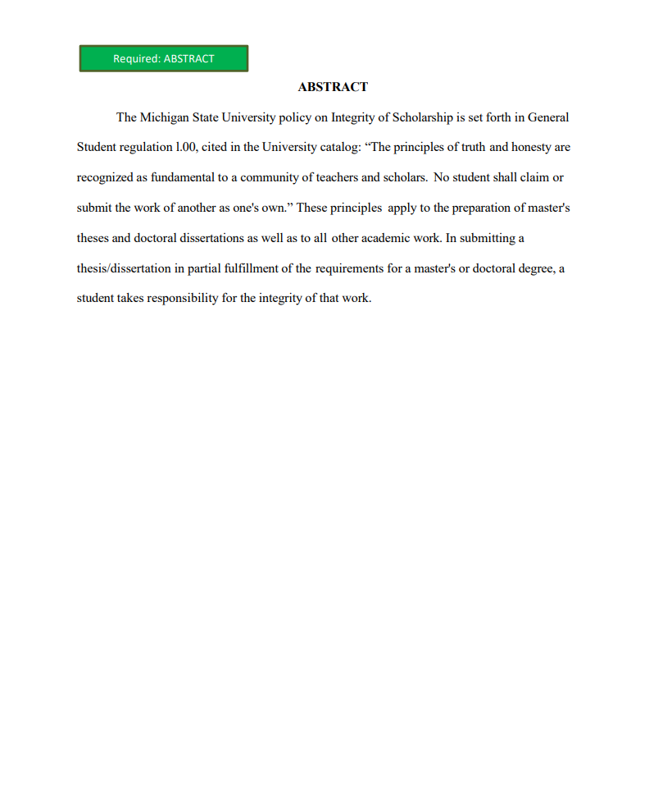
ABSTRACT PAGE
A Master’s thesis abstract may not exceed one page
A Doctoral dissertation abstract may not exceed two pages.
Notes:
After the title page comes the Abstract page. This is a required page. All documents must contain an Abstract.
A thesis abstract may not exceed 1 page. A dissertation abstract may not exceed 2 pages.
On the abstract page, the heading ABSTRACT should appear at the top margin, centered left to right, in all capital letters. Then following the spacing guidelines, begin the text of the Abstract.
Reminder: the abstract page is counted, but not numbered.

Slide 25
To Copyright or not to Copyright?
Your rights as an author are automatically protected, even without copyright registration.
HOWEVER, copyright registration establishes a public record that often helps in legal disputes about intellectual ownership.
Copyright registration can be recorded with the U.S. Customs Service for international protection of your intellectual property.
DECIDE IF YOU WANT PROQUEST TO FILE A COPYRIGHT ON YOUR BEHALF BEFORE YOU COMPLETE YOUR INITIAL SUBMISSION. YOU CANNOT ADD IT AFTER THE FACT BECAUSE YOU NEED TO PAY FOR IT UP FRONT.
NOTE: ProQuest may only apply for a copyright on your behalf if you are the SOLE author of the ENTIRE document. If you co-wrote chapters of your document with someone else, ProQuest cannot apply for copyright on your behalf. You would need to do that yourself through the U.S. Copyright office.
Notes:
The next page that could appear in your document is the Copyright page. This page is optional if you are not requesting that ProQuest file a copyright on your behalf. If you do want ProQuest to file a copyright for you, you must include the copyright page in your document. Please note, that you must choose whether to have ProQuest file a copyright on your behalf when you are creating your account in ProQuest. There is a fee associated with the copyright filing, and you must pay it when you create your account. Currently, the fee is $75. You are not required to have ProQuest file a copy on your behalf.
People often wonder whether they should have a copyright or not. Your rights, as an author, are automatically protected even without copyright registration. But copyright registration does establish a public record that often helps in legal disputes about intellectual ownership. Copyright registration can be recorded with the US Customs Service for international protection of your intellectual property. MSU does not require that you file a copyright through ProQuest.

Slide 26
For further questions about copyright or intellectual property…
MSU Office of Copyright
copyright@msu.edu
(517) 884-1960
Questions about Intellectual Property should be directed to MSU Technologies
(517) 355-2186
http://www.technologies.msu.edu/
Notes:
If you have further questions about Copyright or Intellectual Property, please contact the MSU Office of Copyright or MSU Technologies via the contact information provided on this slide.

Slide 27
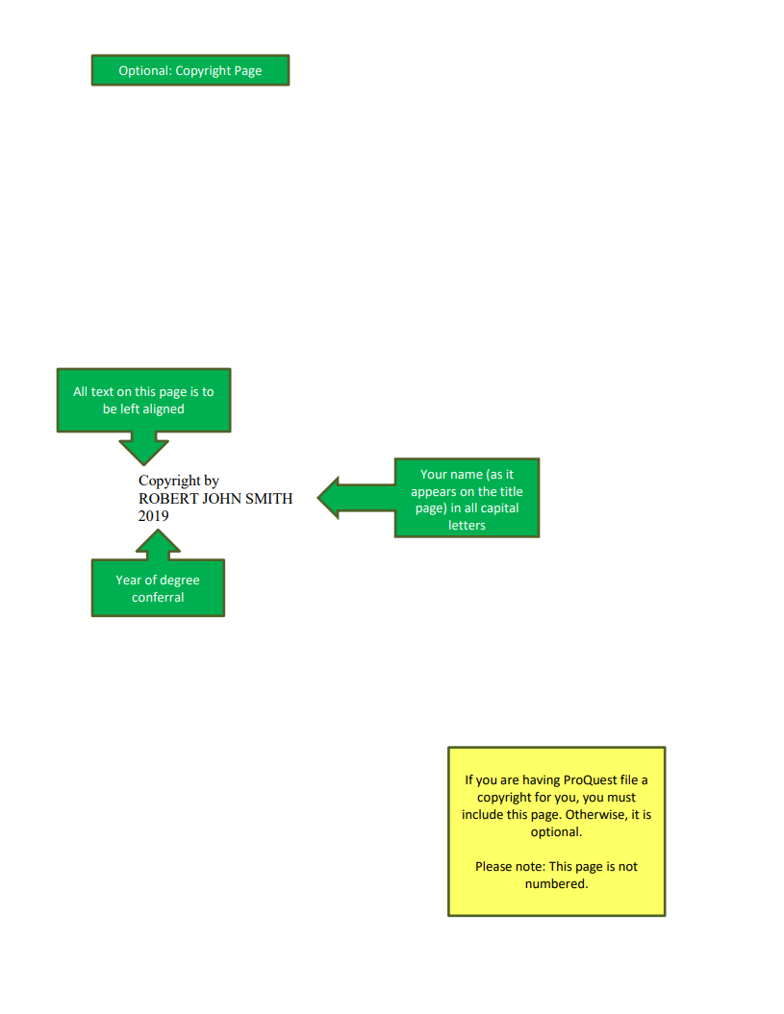
Copyright Page
Your copyright page should look similar to this page. “Copyright by” is on the first line, your name (in all capital letters) is on the second line and the year is on the third line. The entire section is to be single-spaced.
You may place the information anywhere on the page as long as follow the margin requirements.
You are to count, but not number, this page.
Note: Your name, listed on this page, must match the rest of your submission.
Notes:
Here is a sample copyright page.
If you have a copyright page in your document, the information is to be included on 3 lines. The first line is to say “Copyright by”. The second line is to have your name, listed in all capital letters. The third line is to have the year. This text is to be single spaced and left aligned.
Reminder: this page is counted, but not numbered.

Slide 28
Page Orientation and Page Number Location
Portrait Oriented Page
Landscape Oriented Page
5
Regardless of the orientation of the page, the page number is always ½ inch to 1 inch from the bottom of the page.
4
Notes:
Page numbers are to be at the bottom of the page, regardless of the orientation. They should be ½ inch to an inch from the bottom of the page. They may be centered, right aligned, etc. as long as they are consistent throughout the document. Meaning you can’t have some pages with the page number centered and others with it at the right margin.

Slide 29
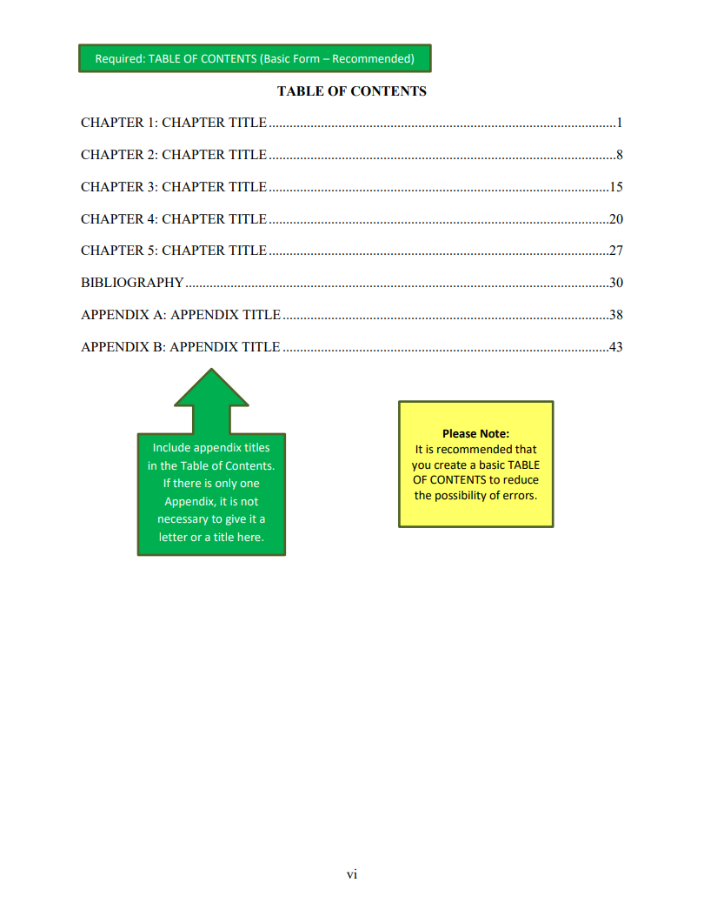
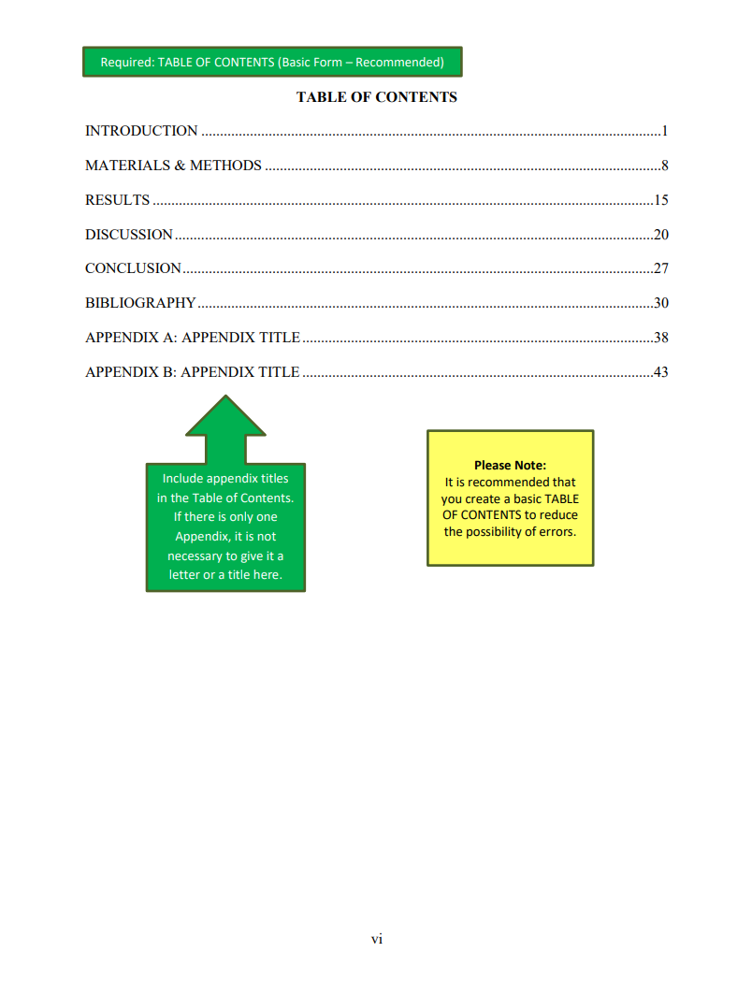
TABLE OF CONTENTS (Recommended)
Basic with chapters
Basic with major sections
Notes:
There are additional preliminary pages—dedication, acknowledgments, etcetera that are prior to the Table of Contents—for information regarding these pages, refer to the formatting guide.
There are two examples of the Table of Contents shown here. Both are the recommended basic forms. We no longer require subheadings to be listed and we encourage you not to. If you do want to list subheadings we only want the level one subheadings. We will ask you to remove anything beyond a level one subheading. The more listings the longer it takes us to review as we must ensure that each heading and subheading matches in the TABLE OF CONTENTS and the document in terms of wording, capitalization, and punctuation.

Slide 30
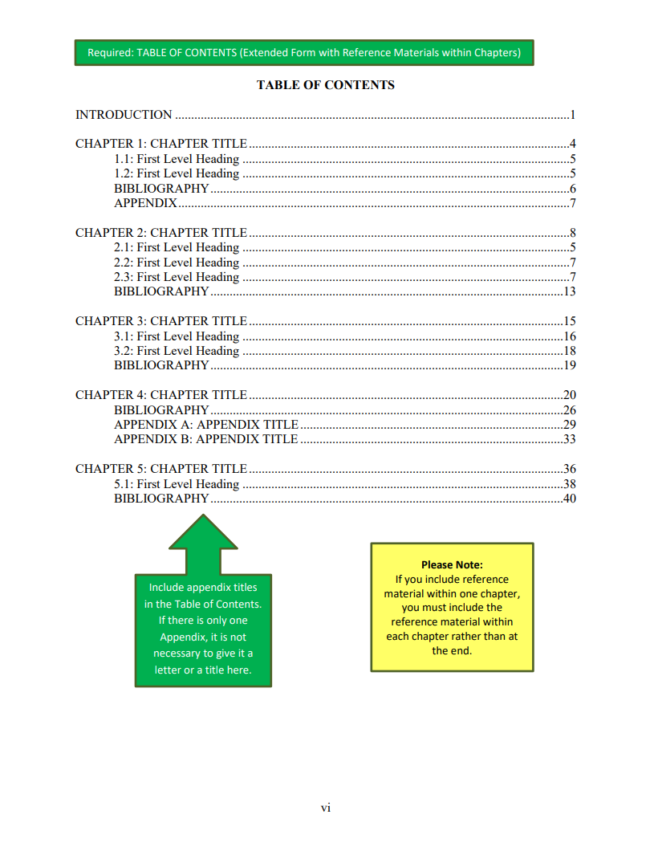
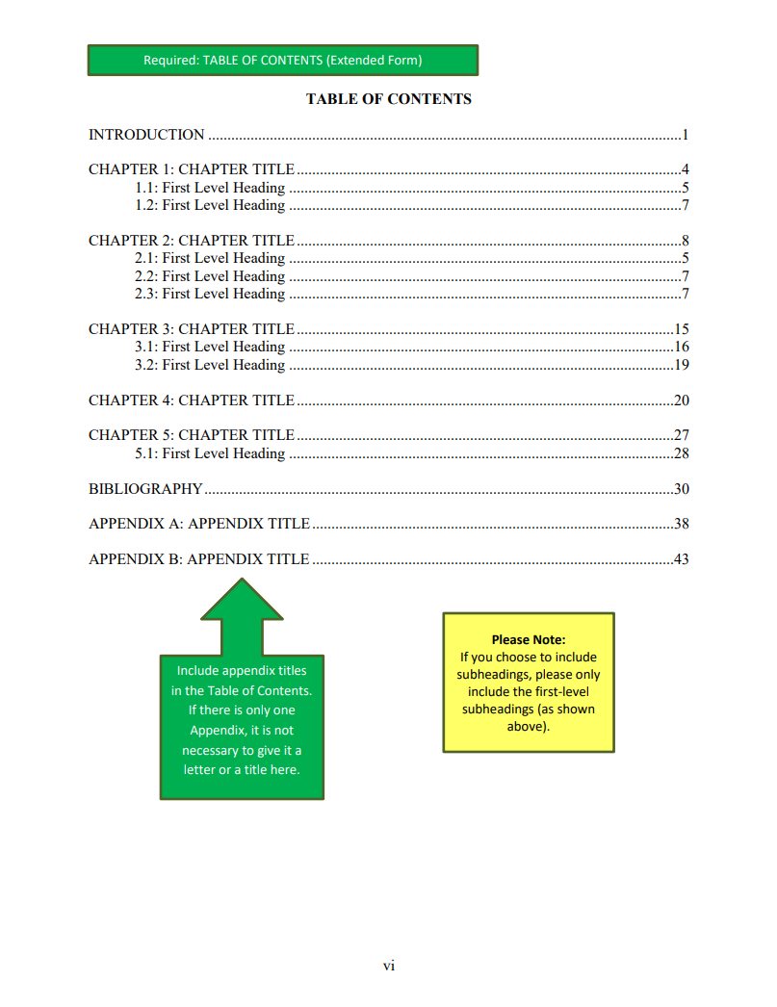
TABLE OF CONTENTS (Extended)
REFERENCE MATERIALS within chapters
REFERENCE MATERIALS AT THE END
Notes:
These are examples of the extended form of the Table of Contents. As you can see there are level one subheadings here. Please do not include anything beyond a level one subheading.
The use of leader dots is required for all entries.
Please refer to the formatting guide and sample pages for all the Table of Contents options and examples.

Slide 31
Table of Contents
All chapter titles must be listed in the Table of Contents. You may choose to list the first level sub-headings, but they are not required.
All wording, capitalization and punctuation of headings and sub-headings MUST match in the body of the document and the Table of Contents.
Notes:
Please note in the Table of Contents:
All chapter headings (or their equivalent if you are not using chapter headings) must be listed in the Table of Contents.
All wording, punctuation, and capitalization of your headings and sub-headings (if listed) must match exactly in the document and the table of contents.

Slide 32
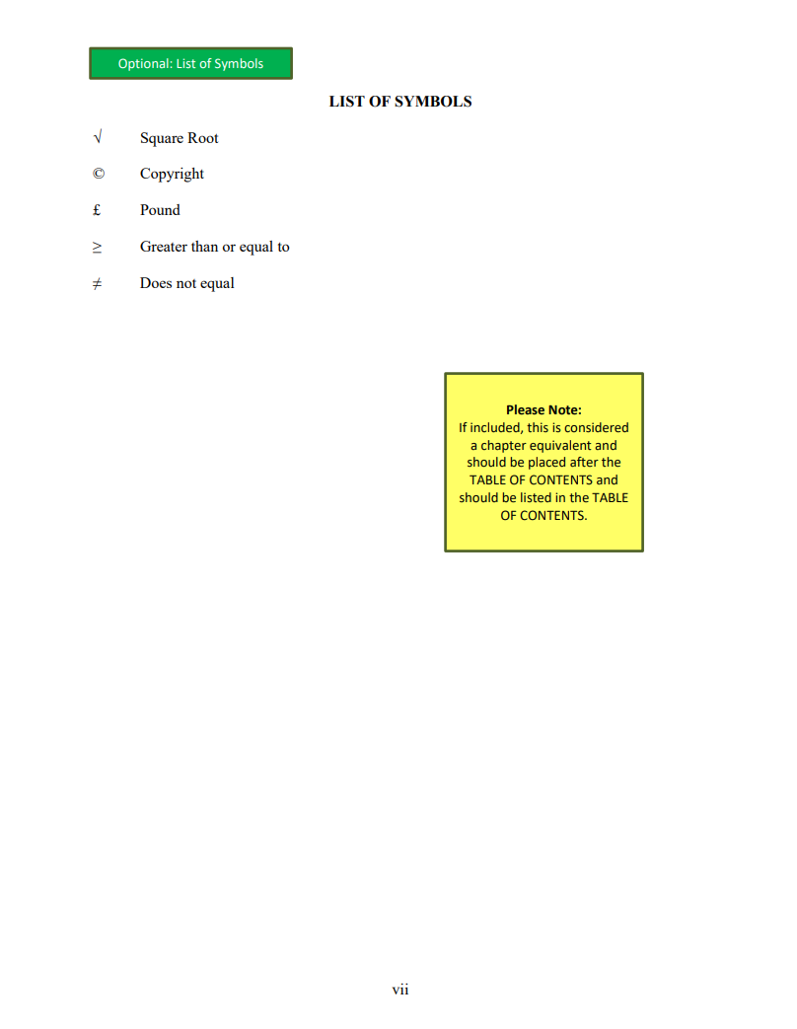
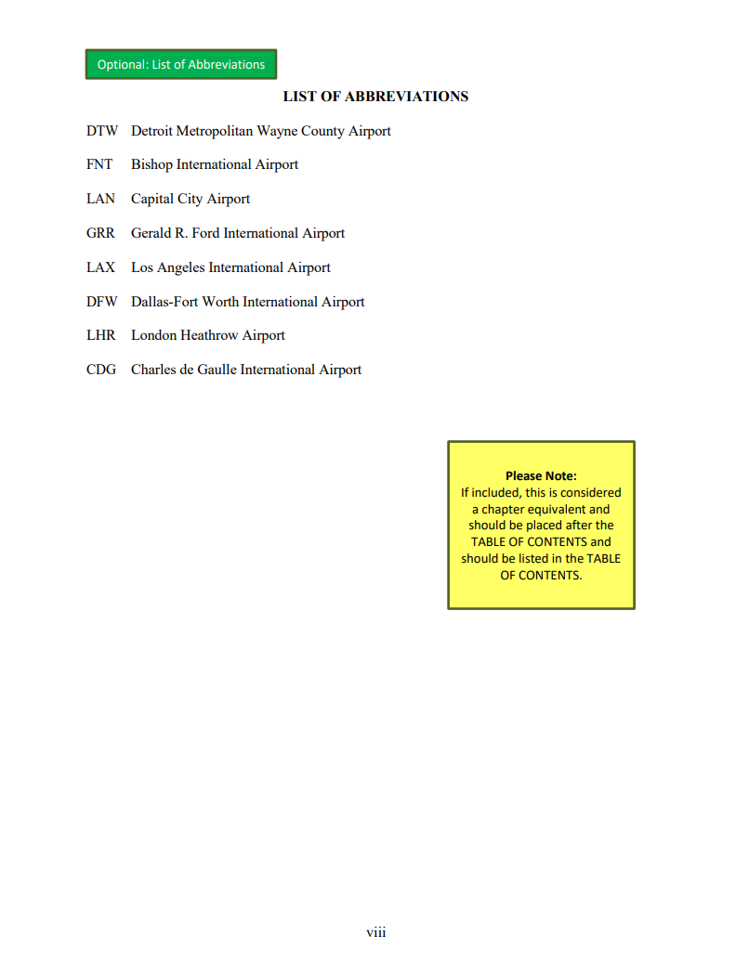
Sample LIST OF SYMBOLS/LIST OF ABBREVITATIONS
Notes:
Here, we have examples of how the LIST OF SYMBOLS and LIST OF ABBREVIATIONS should be set up. These are not required pages.
If you are including a LIST OF TABLES and/or LIST OF FIGURES (which again, we are discouraging as they drastically increase the time it takes to review a document) they should be set up like these lists. We do have a sample LIST OF TABLES page in our sample page packet on our website.
Table and figure entries are to be single spaced within multi-line entries and there should be one double (or 1.5) space between each entry. Please note that if a LIST OF TABLES/FIGURES is included, the figure and table names and captions listed must match exactly with what is in the document in terms of wording, capitalization, and punctuation.

Slide 33
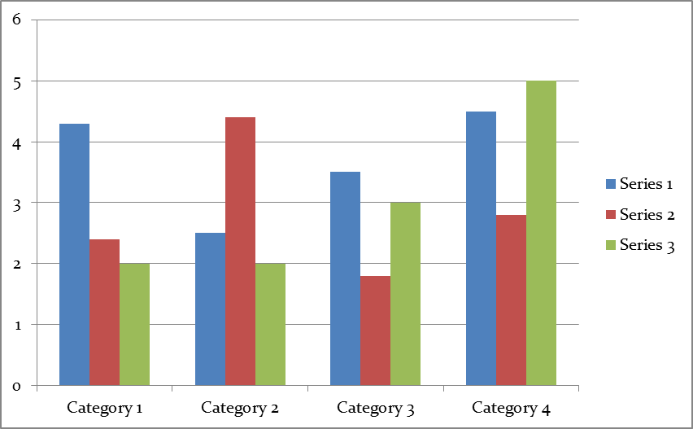
If a figure continues from one page to the next…
The continuation statement is to be on the top line of the page. Don’t repeat the caption.
Figure 1 (cont’d)
18
17
Notes:
Regarding figures:
If you have a figure or a figure caption that continues onto a subsequent page, you need to know the following: The figure name and at least the beginning of the caption are to appear on the first page WITH the figure. Subsequent pages would have as an example Figure 1 (cont’d) on the TOP line of the page. You would then continue with the figure or caption.
You must be consistent in where you place your figure names and captions throughout the document. Above the figure, or below as in this case, is fine. You just need to have the same figure name and caption placement location for all figures in your document. When a figure continues from one page to the next, the continuation statement is ALWAYS at the TOP of the page even if the original caption on the previous page was below the figure.

Slide 34

If a table continues from one page to the next…
Table 1.1 (cont’d)
The continuation statement is to be on the top line of the page. Don’t repeat the caption.
15
16
Notes:
All tables and figures, regardless of their location in the document, must be numbered and captioned. If you have a LIST OF TABLES and/or a LIST OF FIGURES, all tables and figures must be included in them.
Regarding tables:
If you have a table or a table caption that continues onto a subsequent page, the table name and at least the beginning of the caption are to appear on the first page WITH the table. Subsequent pages would have, as an example Table 1.1 (cont’d) on the TOP line of the page. You would then continue with the table or caption.
You must be consistent in where you place your table names and captions throughout the document. Above the table , or below, is fine. You just need to have the same table name and caption placement location for all tables in your document. When a table continues from one page to the next, the continuation statement is ALWAYS at the TOP of the page even if the original caption on the previous page was below the table.

Slide 35
REFERENCE PAGES
Bibliography
Appendix/Appendices
NOTE: APPENDIX pages are always last, regardless of being placed at the end of each chapter or at the end of the document. If you have an appendix, it is to appear AFTER the Bibliography.
Notes:
The References pages consist of:
The bibliography and the appendix or appendices.
Reminder: APPENDIX pages are always last regardless of being placed at the end of each chapter or at the end of the document. If you have an appendix it is appear AFTER the Bibliography.

Slide 36
What is an Appendix?
An Appendix is usually added to contain supplementary materials, illustrative materials, and/or original data or quotations too lengthy for inclusion in the text of the chapter or is not immediately essential to an understanding of the text.
Notes:
You do not need to include items like your IRB or IACUC letters, embargo form, or approval form in the appendix.

Slide 37
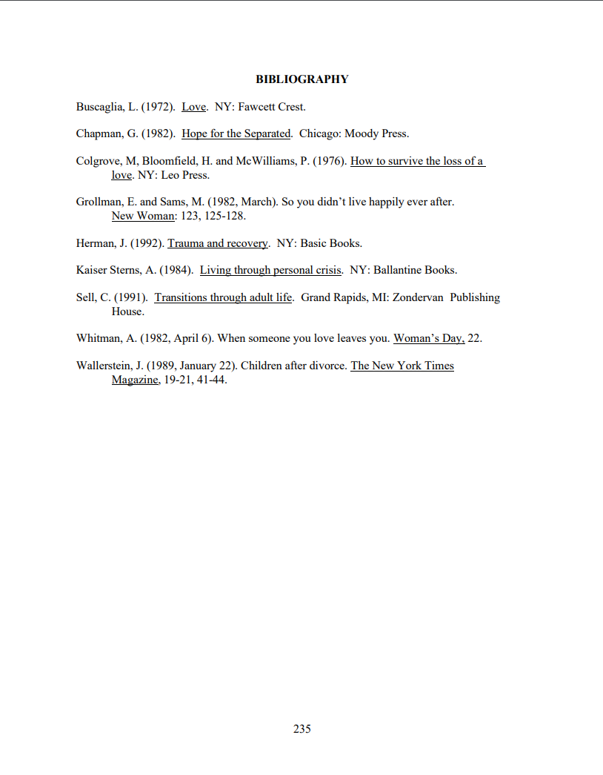
Sample BIBLIOGRAPHY
The heading BIBLIOGRAPHY is to be centered at the top margin of the page and is to be in all capital letters.
After the heading, follow the spacing guidelines and list your first entry.
Bibliography entries are to be single spaced within entries and double (or 1.5) spaced once between entries.
You should format your entries in the way that is the convention in your discipline. We just ask that all your entries are formatted the same way to maintain consistency.
Notes:
The heading BIBLIOGRAPHY is to be centered left to right, at the top margin of the page and it is to be in all capital letters.
After the heading, follow the spacing guidelines and list your first entry.
Bibliography entries are to be single spaced within entries and double (or 1.5) spaced once between entries.
You should format your entries in the way that is the convention in your discipline. All of your entries are to be formatted the same way to maintain consistency.

Slide 38
COMMON FORMATTING ERRORS
Incorrect margins (too small or unequal)
Title page formatted incorrectly
Table of Contents formatted incorrectly
Incorrect page numbering of the preliminary pages
Spacing issues
Font size inconsistency
REMINDER: READ AND FOLLOW THE CURRENT FORMATTING GUIDE BEFORE SUBMITTING YOUR DOCUMENT VIA PROQUEST.
Notes:
Some of the most common formatting errors that we see are:
Incorrect page numbering of the preliminary pages.
Incorrect margins.
Incorrect formatting of the Title page.
Incorrect formatting of the Table of Contents.
This should serve as a reminder to read and follow the formatting guide before submitting your document via ProQuest.
DO NOT use a bound copy of a document from your department or the library as an example.

Slide 39
Now, on to ProQuest…
Using the step-by-step instructions on the Graduate School and ProQuest websites, you will be able to successfully submit your thesis/dissertation electronically.
At the ProQuest site you will be given the option to register for a copyright as part of your electronic submission. Note: Registering for a copyright must be done at the onset when you are creating your submission. YOU MAY NOT ADD IT AFTER THE FACT. You must pay for it up front.
Notes:
On to ProQuest:
Using the instructions on the Graduate School’s website (http://grad.msu.edu/etd/) you will be able to successfully submit your thesis or dissertation electronically.
REMINDER: at the ProQuest site you will be given the option to register for a copyright as part of the electronic submission. You must choose to register, or not, for a copyright at the onset when creating your account. There is a fee that must be paid up front if you do choose to have a copyright. You may not add a copyright after the fact. This issue cannot be stressed enough.

Slide 40
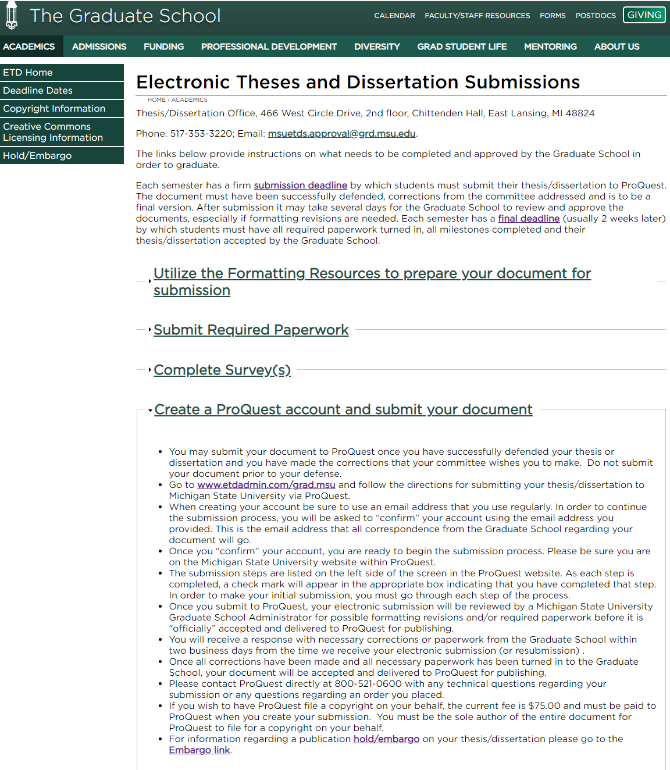
Screenshot of ProQuest section https://grad.msu.edu/etd
Notes:
From the Graduate School’s thesis and dissertation site, click on the “Create a ProQuest account…” from the drop-down menu. Then click on the hyperlink in the second bullet point. This heading gives you the link to ProQuest’s site and some additional information you need to know when creating your account.

Slide 41
IMPORTANT!
Submit to ProQuest ONLY after you have successfully defended and after you have made the corrections to your document that your committee wishes you to make.
The document that you are to submit via ProQuest is one that is ready to go to publishing once it is formatted correctly. This means that NO other corrections need to be made to the CONTENT of the document.
RECOMMENDATION: check your grammar and spelling before you do the initial submission to ProQuest. The Graduate School does not read the documents for content. We are only looking at the formatting.
Notes:
I cannot stress this enough…Do not submit your document via ProQuest before your defense or before you have made the corrections that your committee requires.
You should also be aware that if you submit your document via ProQuest and it is considered to be formatted correctly at the very first submission and all required paperwork has been turned in—your document will be accepted and delivered for publishing even if you weren’t ready for it to be published. Some students in the past have submitted a perfect document, submitted all the required paperwork and they hadn’t even defended yet. It is a time-consuming process to get the document back from ProQuest’s production queue and out of the MSU library so that you can make additional changes.
The document that you submit for the first time via ProQuest needs to be the one that is ready to go to publishing once it is deemed to be formatted correctly. This means that no further corrections need to be made to the content—you have successfully defended and have already made the corrections that your committee required.
It is highly recommended that you check your spelling and grammar before you do the initial submission to ProQuest. The Graduate School does not read the documents for content. We are only looking at the formatting.

Slide 42
A few more comments about your document
The Graduate School only reviews documents that have been submitted through the ProQuest system.
The Graduate School does not do “format checks” before you submit your document to ProQuest.
The Graduate School is happy to answer any specific formatting questions you may have about your document at any time.
Notes:
A few additional comments about submitting your document:
First: DO NOT email a word version or a PDF version of your document to the Graduate School for review. We only review documents that have been submitted through the ProQuest system
Secondly: We do not do “format checks” before you submit your document to ProQuest. You are to read and follow the formatting guide to the best of your ability, prepare your document accordingly, and submit to ProQuest after your defense and after you have made the corrections your committee requests.

Slide 43
EVERY STUDENT MUST COMPLETE THE FOLLOWING ITEMS
Prepare your document using the current formatting guide (Available at https://grad.msu.edu/etd)
Submit Your Approval Form to the Graduate School (All students)
Complete the Graduate School Exit Survey (All students)
Doctoral students must complete the Survey of Earned Doctorates (SED) online
Now, go to http://www.etdadmin.com/grad.msu and follow the directions for submitting your thesis/dissertation to Michigan State University via ProQuest/UMI.
Notes:
To get the process going for publication in ProQuest….
Every student is to prepare their thesis or dissertation following the current formatting guide.

Slide 44
EVERY STUDENT MUST COMPLETE THE FOLLOWING ITEMS
Prepare your document using the current formatting guide (Available at https://grad.msu.edu/etd)
Submit Your Approval Form to the Graduate School (All students)
Complete the Graduate School Exit Survey (All students)
Doctoral students must complete the Survey of Earned Doctorates (SED) online
Now, go to http://www.etdadmin.com/grad.msu and follow the directions for submitting your thesis/dissertation to Michigan State University via ProQuest/UMI.
Notes:
Then, every student must turn in a completely and accurately filled out approval form.

Slide 45
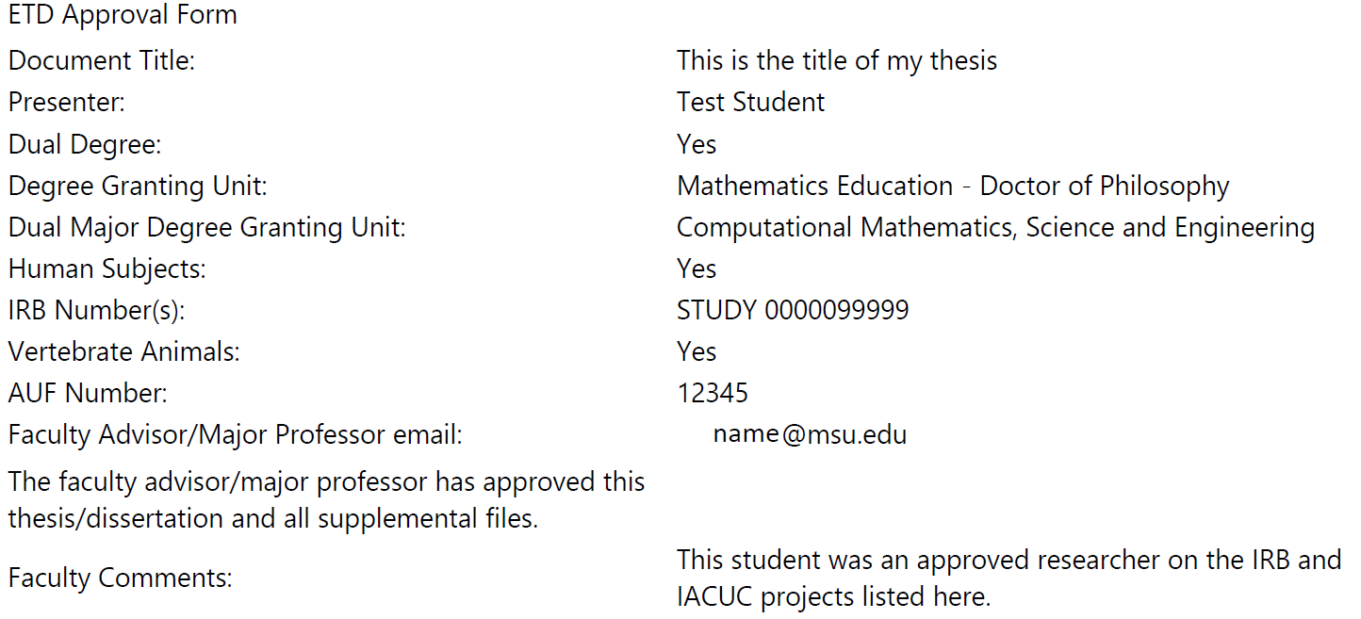
ALL STUDENTS MUST SUBMIT AN ETD Approval Form
  Thesis or Dissertation Title
  Your name as it is written on your Thesis or Dissertation
  Your Degree Granting Unit and degree
  Are you a PhD student with an approved dual major?
    Yes: your secondary College and Degree Granting Unit
  Does the thesis or dissertation you are submitting include research involving human subjects or materials of human origin?
    Yes: IRB Log Number
    Yes: Institutional Review Board approval letter and other documentation
  Does the thesis or dissertation you are submitting include research involving vertebrate animals in any way?
    Yes: AUF Number
    Yes: IACUC letter
  The MSU email address of your faculty advisor/major professor.
Notes:
You can see a sample of the approval form on the right. It is an online form that is found on our website.
The title of your document is to be listed exactly as it is in your ProQuest account and on your title page.
Your name is to be listed exactly as it appears on your ProQuest account, title page, and copyright page (if you have a copyright page). This must be the name recognized by the MSU registrar’s office. No nicknames are allowed.

Slide 46
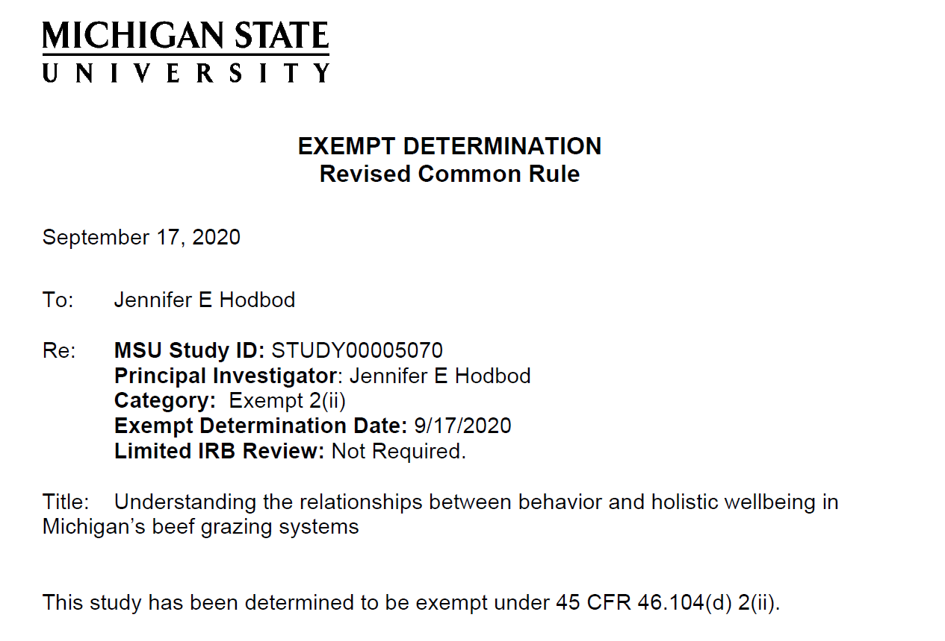
IRB LETTER
If your name is not listed on the IRB letter you will need to provide proof that you are an approved researcher on the project.
Research with Human Subjects Contact:
irb@ora.msu.edu
4000 Collins Rd, Suite 136
Lansing, MI 48910
Phone: 517-884-6020
Website: http://www.hrpp.msu.edu
Notes:
Here is an example of IRB letter.
This letter is going to be addressed to your Principle Investigator (or PI). Your name may or may not be cc’d on the bottom.
If you have questions about research with human subjects and whether IRB approval is needed for your project, you need to contact the IRB office at the contact information on this page.

Slide 47
Acceptable Proof for IRB projects when your name does not appear on the IRB letter
Send a screenshot from the “CLICK” site where you are listed as a researcher (CLICK screenshot must start at the green box that says “APPROVED” and extend so it includes information in the “Contacts” tab below the flow chart. We must see your name and your role in the project).
OR
Have your PI send an email to msuetds.approval@grd.msu.edu stating the IRB number, the project title, and that you are an approved researcher on the project.
Notes:
What are acceptable forms of proof that you are an approved researcher on a project?
The first option is to submit a CLICK screenshot. The CLICK screenshot must start at the green box that says “APPROVED” and extend so it includes information in the “Contacts” tab below the flow chart. We must see your name and your role in the project.
If you are not submitting a CLICK screenshot, then you will need the PI to send an email to the emailed listed here with the IRB number, title of the project, your name, and a statement saying you were an approved research on the project. If your advisor is not the PI, then they may not confirm you were an approved researcher. Only the PI can do this.

Slide 48
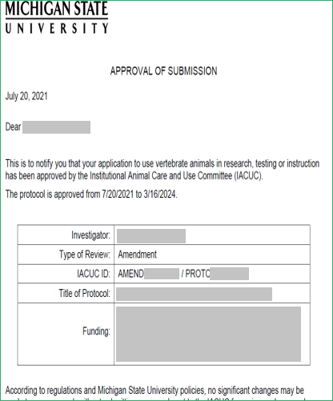
IACUC LETTER
If you used vertebrate animal subjects, you must provide a copy of the IACUC approval letter.
Research with Animal Subjects Contact:
iacuc@msu.edu
4000 Collins Rd, Lansing, MI 48910
Phone: 432-8103
Website:
http://www.animalcare.msu.edu
Your name will not appear on this letter—only your PI’s name will be on this letter.
Notes:
If you used vertebrate animal subjects, you must provide a copy of the IACUC letter. This letter will be addressed to your PI. Your name will not be listed on this letter.
If you have questions about research with vertebrate animal subjects and whether IACUC approval is needed for your project, you need to contact the Animal Care office at the contact information on this page.

Slide 49
EVERY STUDENT MUST COMPLETE THE FOLLOWING ITEMS
Prepare your document using the current formatting guide (Available at https://grad.msu.edu/etd)
Submit Your Approval Form to the Graduate School (All students)
Complete the Graduate School Exit Survey (All students)
Doctoral students must complete the Survey of Earned Doctorates (SED) online
Now, go to http://www.etdadmin.com/grad.msu and follow the directions for submitting your thesis/dissertation to Michigan State University via ProQuest/UMI.
Notes:
All students must complete the graduate school exit survey.
Only students who have applied to graduate will have access to this survey. On our website there is information about what you should do if you have applied to graduate, but you still do not have access to the survey.

Slide 50
Graduate School Exit Survey
On-line Instructions
Your participation in this survey is important and it is greatly appreciated by the Graduate School. The Graduate School uses data from this survey when reviewing graduate programs and to guide decisions about services and initiatives for graduate students.
Only students who have applied for graduation will have access to the online survey and the identity of all respondents will be kept confidential.
Survey websites:
  Doctoral Students: https://www.egr.msu.edu/doctoral/survey
  Master’s Students: https://msu.12twenty.com
Notes:
Participation in the exit survey is important because data from this survey is used in guiding decisions about services and initiatives for graduate students.
Your identity is kept confidential.
The links for the doctoral and master’s surveys are listed here and on our website.

Slide 51
EVERY DOCTORAL STUDENT MUST COMPLETE THE FOLLOWING
Prepare your document using the current formatting guide (Available at https://grad.msu.edu/etd)
Submit Your Approval Form to the Graduate School (All students)
Complete the Graduate School Exit Survey (All students)
Doctoral students must complete the Survey of Earned Doctorates (SED) online
Now, go to http://www.etdadmin.com/grad.msu and follow the directions for submitting your thesis/dissertation to Michigan State University via ProQuest/UMI.
Notes:
All doctoral students are to complete the Survey of Earned doctorates. The survey takes about 10 minutes to complete, and it is vital that you fill it out as completely as possible.

Slide 52
Survey of Earned Doctorates (SED)
Survey of Earned Doctorates (SED) online
Go to https://sed-ncses.org and complete the registration process.
You will be sent an email with a PIN, a password and a link to the web survey.
Notes:
The link listed on this page will take you to the registration screen for the survey.
You will then be emailed a PIN, a password, and a link to the web survey.

Slide 53
Survey of Earned Doctorates (SED)
Michigan State University REQUIRES verification of completion of the SED. When you submit your survey, a notification of completion will be automatically sent to the Michigan State University Graduate School Office.
It is also recommended at the end of the survey you have a copy of the ‘certificate of completion’ emailed to your own personal email for your records.
Notes:
Michigan State University requires verification of completion of this survey. It is part of the required paperwork that we need for all doctoral students. After you complete the survey a copy of the certificate of completion is automatically sent to the Graduate School. It is recommended that you have a copy to sent to you for your own records.

Slide 54
EVERY STUDENT MUST COMPLETE THE FOLLOWING ITEMS 5
Prepare your document using the current formatting guide (Available at https://grad.msu.edu/etd)
Submit Your Approval Form to the Graduate School (All students)
Complete the Graduate School Exit Survey (All students)
Doctoral students must complete the Survey of Earned Doctorates (SED) online
Now, go to http://www.etdadmin.com/grad.msu and follow the directions for submitting your thesis/dissertation to Michigan State University via ProQuest/UMI.
Notes:
Now, it’s time to click on the link to go to ProQuest’s site.

Slide 55
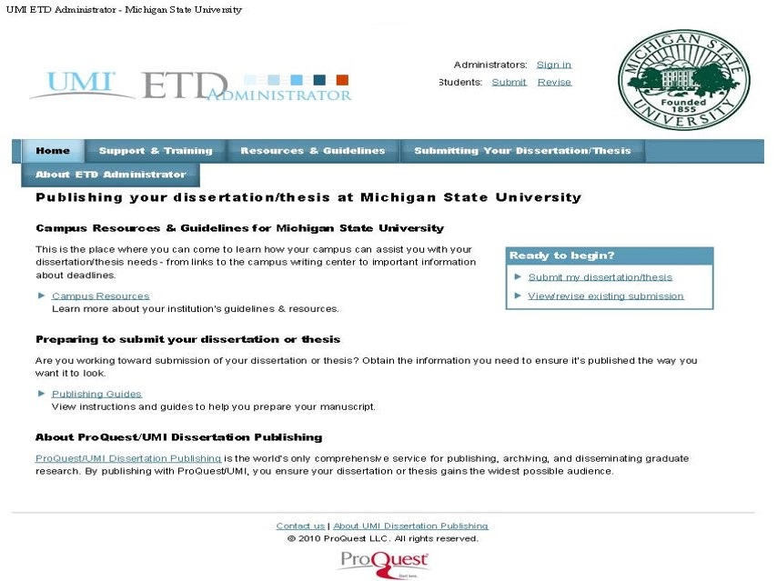
Screenshot of proquest website
Notes:
When you click on that link you will see the MSU seal in the upper right-hand corner and it will have text that says “Publishing your dissertation or thesis at Michigan State University. Make sure it says MSU here.

Slide 56
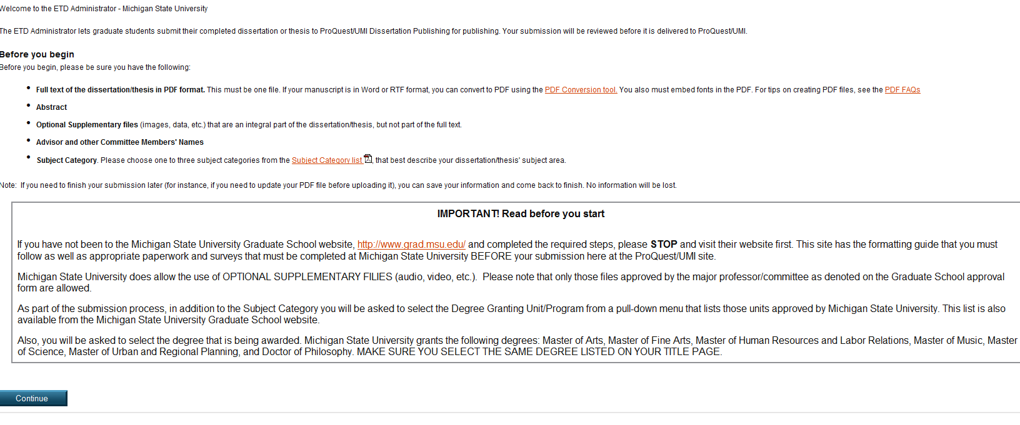
Instructions from ProQuest that you should read through before you begin
Notes:
There are some instructions that you need to read about submitting your document, where to find help, and requirements for MSU. Please read this thoroughly before creating your account.

Slide 57
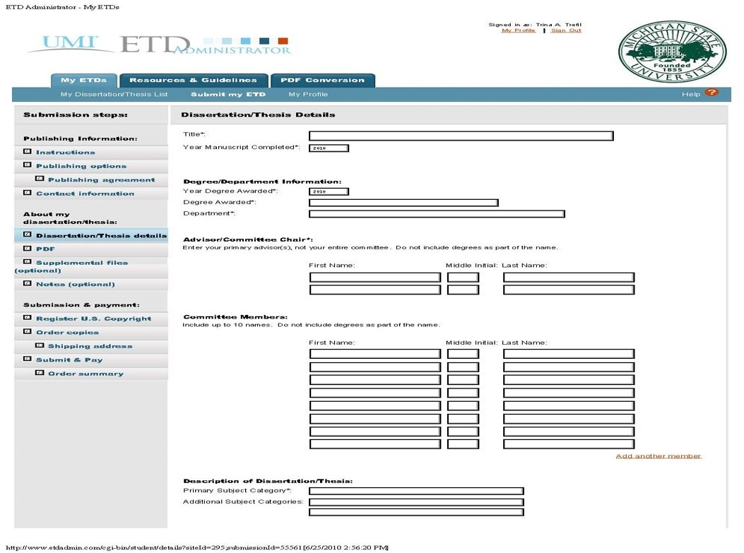
Dissertation/Thesis Details
Notes:
You will have to type in some details
Title of your document
Name
Email
Your degree granting unit and degree
Committee members
Abstract
Etc.
Ensure that your name listed here matches the rest of your submission.
Remember the email address that you enter because this is the address all correspondence regarding your document will go.
Make sure your title is spelled correctly and it matches the rest of your submission

Slide 58
Submission Review
Once you submit your document via ProQuest, your submission will be reviewed by an MSU Graduate School ETD Administrator for possible formatting revisions.
You will be contacted via email with required revisions or with a request for missing paperwork, BEFORE your document is officially accepted and delivered to ProQuest for publishing.
You will receive a response with the necessary revisions from the Graduate School within a timely manner.
The email will be sent to the email address you provided in your ProQuest account.
Notes:
The Graduate School has a handful of ETD Administrators to review documents. During the early parts of each semester, we strive to get notes out to students within 2 business days. As we get closer to our ETD Deadlines each semester, it may take a little longer to get notes out as we get a large influx of documents and, therefore, it takes longer to get to all of them. Each document is reviewed by a person and not run through a program. We always appreciate your patience.

Slide 59
More about the submission to ProQuest
There is no submission to the Graduate School and then a submission to ProQuest once the document is formatted correctly. There is only one submission, and it is to ProQuest.
The ProQuest website is where the Graduate School accesses your document and reviews the formatting.
Any corrections that need to be made will be sent from Graduate School staff via ProQuest’s website.
Notes:
There is no submission to the Graduate School and then a submission to ProQuest. There is only one submission, and it is to ProQuest.

Slide 60
Permission to Reprint
If you have chapters/materials in your document that have been previously published elsewhere, you MUST upload the permission documents from the original publisher to your ProQuest account. These need to be uploaded to the Copyright section in your ProQuest account.
ProQuest will not publish your document without the permission/copyright documents being uploaded in your account.
Notes:
If you have chapters/materials in your document that have been previously published, you MUST upload the permission documents from the original publisher to your ProQuest account details. These need to be uploaded to the Copyright section in your ProQuest account.
Do not add these to your supplemental files section.

Slide 61
Permission to Reprint (cont’d)
If you have material in review for a journal/magazine/etc., please reach out to the publisher to verify the legalities of using that same material in your document.
If the reprinted work is your own material, depending on your agreement with the publisher, you still may need permission from them to include it in your thesis or dissertation.
Notes:
Please note that even if the reprinted material is your own work, depending on your agreement with the publisher, you still may have to obtain permission from that publisher to include it in your thesis or dissertation.

Slide 62
Degree completion flowchart: Semester of graduation
Responsibility of the Student
Complete and Submit Application for Graduation
Make sure Grad Plan/RCR requirements/Degree Audit are complete
Check deadline dates
Completion of program requirements, see Academic Programs at
http://www.reg.msu.edu/AcademicPrograms/Default.asp
Submit thesis or dissertation to ProQuest via the Graduate
School webpage with all necessary paperwork
Complete Survey(s)
Responsibility of the Graduate School
Final acceptance of thesis or dissertation
Complete thesis or dissertation milestone
Responsibility of the Department/College
Complete outstanding milestones
Ensure Degree Audit is complete
Confer degree
The Office of the Registrar
Approve Final Conferral in SIS
Issue Diplomas
DEGREE COMPLETED
Notes:
Here is the flowchart for what needs to be done so that you can complete your degree and receive your diploma.

Slide 63
Your responsibilities as a student
Complete and Submit Application for Graduation
Make sure Grad Plan/RECR Requirements/Degree Audit are complete
Check deadline dates
Must be enrolled in at least 1 credit in the semester of defense. Domestic students do not have to be enrolled to make revisions in the next semester. International students should check with OISS to see if they need to be enrolled in the semester after the defense to maintain student status while working on revisions.
Completion of program requirements, see Academic Programs Catalog at http://www.reg.msu.edu/AcademicPrograms/
Complete required survey(s)
Submit thesis or dissertation via the ProQuest website AND turn in all necessary paperwork, see https://grad.msu.edu/etd
Notes:
You, as the student, have multiple responsibilities:
First, apply to graduate
Make sure your Grad Plan/RECR Requirements/Degree Audit are complete
Know the deadline dates
You must be enrolled in at least 1 credit the semester of your defense. Domestic students do not have to be enrolled to make revisions in the next semester. International students should check with OISS to see if they need to be enrolled in the semester after the defense to maintain student status while working on their revisions.
You need to check the Academic Programs’ catalog to make sure that you have completed all the coursework and requirements for your program.
Submit your thesis or dissertation via ProQuest and turn in all your necessary paperwork

Slide 64
All students need to apply for graduation
Log-in to student.msu.edu
On your student home page, click on the Academic Progress Tile
Click on the Graduation folder drop-down
Click Apply for Graduation and follow the directions to fill out the application
Notes:
All students must apply for graduation, even if you don’t intend to take part in the graduation ceremony.
This slide shows the process for how to apply for graduation.

Slide 65
Grad Plan and RECR Requirements
All graduate students must have a completed Grad Plan prior to graduation.
  Grad Plan consists of:
    Annual Research Overview (completed each academic year)
    Committee
    Course Plan
    Annual Review (completed each academic year)
    All graduate students must have completed the required RECR requirements for their degree.
    For Grad Plan and RECR questions, please contact gradsis@grd.msu.edu
Notes:
A few words about Grad Plan and RECR Requirements
All Ph.D. students and Master’s student must have a complete Grad plan prior to graduation
Make sure that you have completed all 4 parts of GradPlan: the Annual Research Overview has been completed each year, your committee has been fully approved, your course plan has been fully approved, and you or your department have uploaded the annual review with your advisor each year.
All graduate students must have completed their RECR requirements prior to graduation as well.
For Grad Plan and RECR questions, please contact gradsis@grd.msu.edu

Slide 66
Responsibilities of the
Graduate School
Final acceptance of thesis or dissertation for publishing
Complete thesis or dissertation milestone
Notes:
The responsibilities of the graduate school are as follows:
We handle the final acceptance of your thesis or dissertation for publication.
We complete your milestone showing that your dissertation or thesis has been delivered for publishing

Slide 67
Responsibilities of your Department/College
Complete outstanding milestones
Complete the degree audit as needed
Department/college confers the degree
Notes:
Your department has responsibilities as well.
Your department is to complete outstanding milestones, the degree audit, and confer the degree.

Slide 68
Responsibility of the
Office of the Registrar
After degrees are conferred by the department/college, the Registrar’s Office completes the final conferral and issues the diploma.
If you have questions regarding Degree Certification, please contact:
Office of the Registrar
Email: reg@msu.edu
Notes:
And lastly---the registrar
After the degrees are conferred by the department/college, the Registrar’s office completes the final conferral and issues the diploma.
Your diploma will arrive approximately 6 weeks after your degree is conferred.
If you have any questions about degree certification you should contact the registrar’s office. Their contact information is listed at the bottom of this page.

Slide 69
Degree verification letter
If you need a letter stating that you have completed your degree requirements before your diploma arrives, you may request the letter in student.msu.edu AFTER your degree has been conferred.
  Log-in to student.msu.edu
  On your student homepage, click on the Academic Records Tile
  Click on Enrollment Verification
  For further assistance, please reach out to reg@msu.edu
The Graduate School only handles your thesis or dissertation. We do not know if you have completed all the other requirements to receive your degree or not.
Notes:
If you need a letter stating that you have completed your degree requirements before your diploma arrives, you may request one AFTER your degree has been conferred utilizing the steps listed in this slide. If you need further assistance, please reach out to the Registrar’s office at: reg@msu.edu.
The Graduate School only handles your thesis or dissertation. We do not know if you have completed all your other requirements to receive your degree or not.

Slide 70
Thesis and Dissertation formatting help walk-in sessions
Students may bring specific questions about their documents or questions about formatting requirements to the walk-in sessions. We will not review any documents in its entirety. That happens when the document is submitted to ProQuest.
Please visit https://grad.msu.edu/etd/workshops for the dates/times for our walk-in sessions.
We are available 8:00 am-12:00 pm and 1:00 pm 5:00 pm, Monday-Friday, for assistance if the drop-in sessions do not work with your schedule.
Notes:
We have Thesis and Dissertation walk-in help sessions. These walk-in sessions are for specific questions about your document and formatting requirements. We will not review documents in their entirety at these sessions.
Please visit the website listed here for dates/times for our walk-in sessions. This semester we have two more walk-in sessions coming up.
Thursday, July 10th from 9:30am-11am and
Monday July 21st from 1:30pm-3pm
Walk in sessions take place on the 2nd floor of Chittenden Hall (Room 220). No registration is required.

Slide 71
Resources
The Graduate School
Phone Number: 517-353-3220
E-mail: msuetds.approval@grd.msu.edu
Address: 466 W Circle Drive, Chittenden Hall, 2nd Floor
ProQuest
Phone number: 800-521-0600
E-mail: etdsupport@proquest.com OR disspub@proquest.com
Human Research Protection Program (IRB)
Phone Number: 517-884-6020
E-mail: irb@ora.msu.edu
Address: 4000 Collins Rd, Suite 136, Lansing, MI 48910
Web Address: http://www.hrpp.msu.edu
Research with Animals (IACUC)
Phone Number: 517-432-8103
E-mail: iacuc@msu.edu
Address: 4000 Collins Rd, Lansing, MI 48910
Web Address: http://www.animalcare.msu.edu
Office for International Students and Scholars (OISS)
Phone Number: 517-353-1720
Address: 427 N Shaw Lane, Room 105
E-mail: oiss@msu.edu
MSU Copyright Office
Web Address: https://lib.msu.edu/copyright/
Email: copyright@msu.edu
MSU Technologies (Intellectual Property)
Web Address: http://www.technologies.msu.edu/
Degree and Certification
E-mail: reg@msu.edu
Notes:
This last slide is a resource page with contact information for the various sources you may need or want to utilize during this process.
This concludes today’s webinar. If you have any additional questions, the chat will be open for about 5 more minutes. After that please reach out to the Graduate School at the email address listed on this page.
Thank you for joining us and I hope you have a wonderful rest of your day.

